Slide 1
Stream Processing Technology
Streaming Data Processing
Prajwol Sangat
Updated by Ting Chee Ming

Slide 2




Streaming Platforms

Slide 3
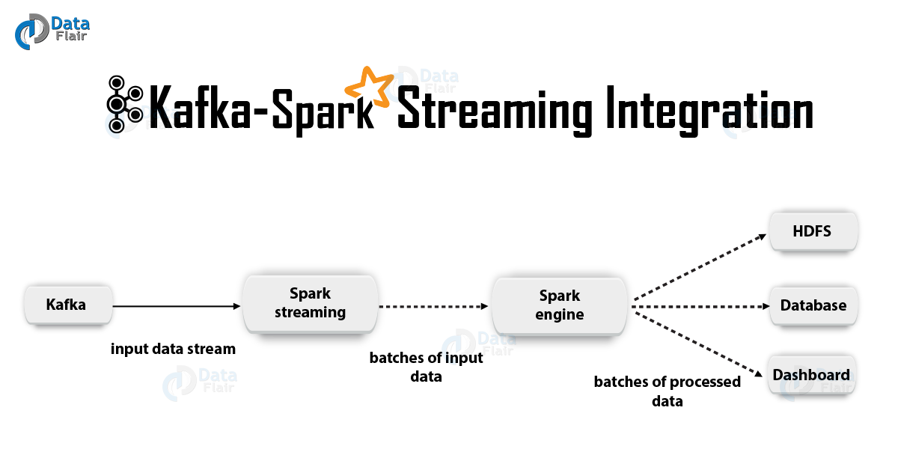
Real-Time Streaming Architecture
Kafka Producer
Send data from producers to processing side
publish data into topics
Producer 1
Producer N
Consumer 1
Data stream
Examples: web host, server, sensors, IOT devices which generate data
Consumer N
Consumer & Spark Streaming
Listen/subscribe to topic and consumes the data

Slide 4
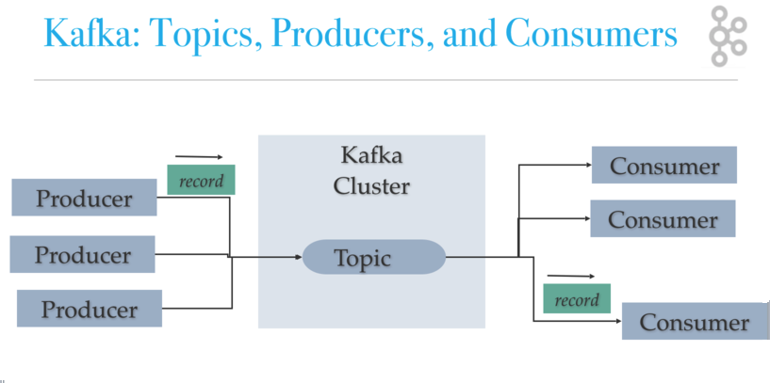
What is Apache Kafka?
Publish-subscribe messaging system
Scalable, Fault-tolerant
Enables distributed applications
Powers web-scale Internet companies such as LinkedIn, NetFlix, AirBnB, and many others.
Producer publish streams of data records into topics
Consumers subscribe to the topics and process the stream of records
https://dzone.com/articles/kafka-architecture
Kafka is run as a cluster comprised of one or more servers (called brokers)
Data in Kafka is stored in topic
- Topic is category/feed name where records are stored
A topic is associated with a log – data structure on disk
Each topic is indexed and stored with timestamp
- A broker receive messages from producers and stores them on disk keyed by unique offset.
- A broker allows consumers to fetch messages by topic, partition and offset
https://kafka.apache.org/081/documentation.html

Slide 5
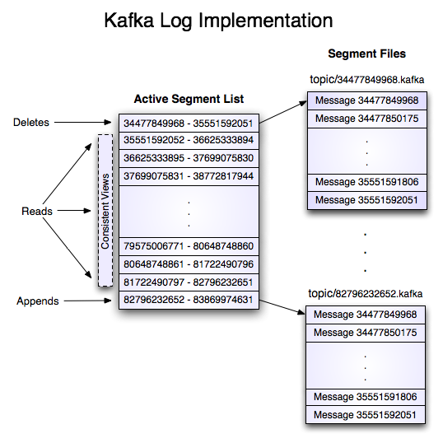
How does Kafka Work?
Topics represent commit log data structures stored on disk
Topics are divided into partitions, each partition is further divided into segments
Each segment has a log file to store the actual message
Log – time-ordered, sequence of messages that is continually appended (each log entry can be array of bytes)
Partitions are replicated and distributed over servers in Kafka cluster (brokers) for fault tolerance (when a server in the cluster fails so messages remain available)
Messages stay around for a configurable period of time (i.e., 7 days, 30 days, etc.).
- Can recover lost messages during time out or lost connection
https://medium.com/@durgaswaroop/a-practical-introduction-to-kafka-storage-internals-d5b544f6925f

Slide 6
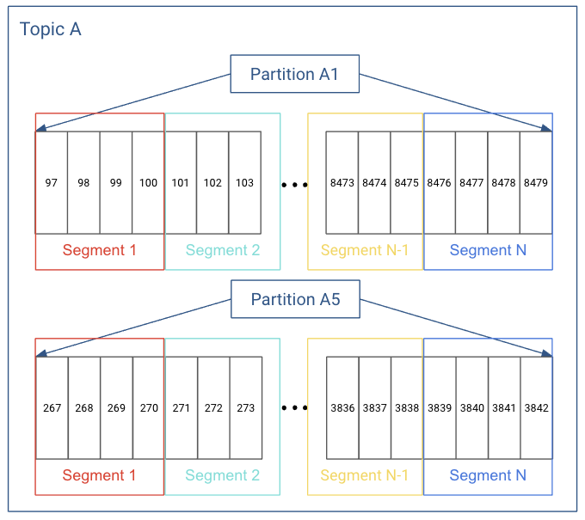
Kafka Storage Structure
Messages are written to it in an append-only fashion
Topic is logical grouping
Partition is actual unit of data storage
Every piece of data stored in segment file is a message
Each message in partition is uniquely identified by an ID called offset
Image source: https://docs.cloudera.com/runtime/7.2.8/kafka-overview/topics/kafka-overview-logs-and-log-segments.html
https://kafka.apache.org/081/documentation.html

Slide 7
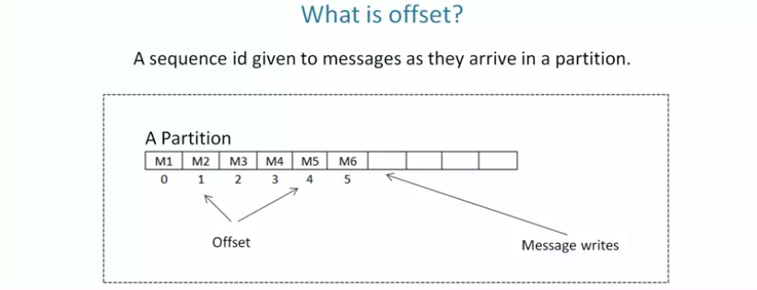
What Kafka doesn’t do?
Kafka does not have individual message IDs. Messages are simply addressed by their offset in the log.
Kafka also does not track the consumers that a topic has or who has consumed what messages.
There are no deletes. Kafka keeps all parts of the log for the specified time.
https://shubhamagtech.home.blog/2019/07/31/kafka-offset-management/

Slide 8
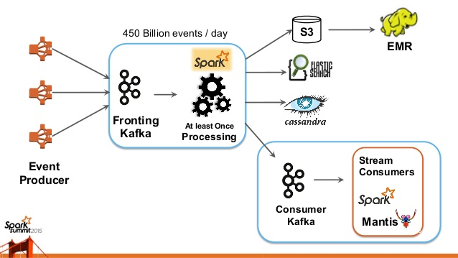
Kafka and big data at web-scale companies
Big Data ingestion at Netflix
https://www.slideshare.net/SparkSummit/spark-and-spark-streaming-at-netfix-sedakar-daxini

Slide 9
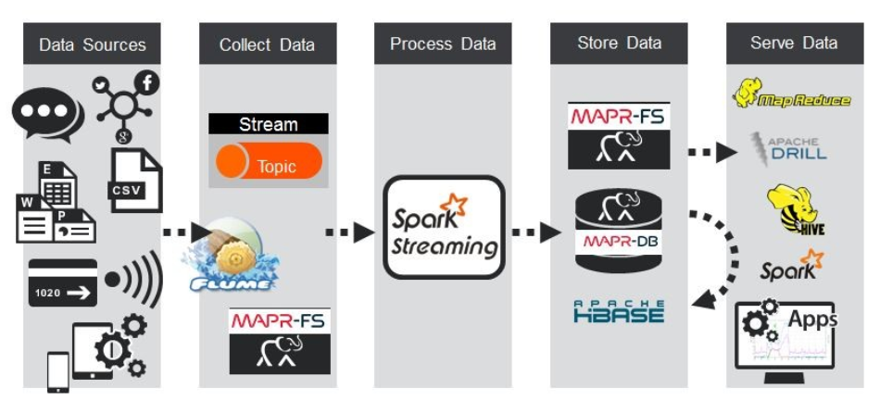
Kafka and big data at web-scale companies
BP OIL USE CASE :
https://www.linkedin.com/pulse/real-time-streaming-data-pipelines-apache-kafka-spark-steven-murhula/

Slide 10
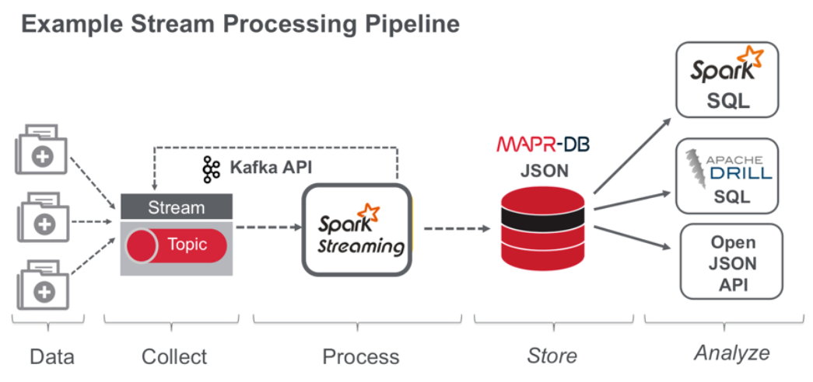
Kafka and big data at web-scale companies
Transform, Store and Explore Healthcare Dataset
https://mapr.com/blog/streaming-data-pipeline-transform-store-explore-healthcare-dataset-mapr-db/

Slide 11
Should you use Apache Kafka?
Kafka fits a class of problem that a lot of web-scale companies and enterprises have, but just as the traditional message broker is not a one size fits all, neither is Kafka.
If you're looking to build a set of resilient data services and applications, Kafka can serve as the source of truth by collecting and keeping all of the "facts" or "events" for a system.

Slide 12
Real-Time Streaming Architecture
Producer 1
Producer N
Consumer 1
Consumer N

Slide 13
DEMO
What is the total number of attendees up to tx?
Assume memory can only keep 5 tuples.
Query
ACC
Keep an accumulator for the sum. There is no need to keep the tuples.
∞
…
1
2
3
4
5
4
2
1
t_{n}
t₀

Slide 14
Thank You
Questions?

